Slide 1


PROJECT
November 14, 2024
Project Name
AQI Analysis
Page 1 of 31

Slide 2
TABLE OF CONTENT
Problem
Overview Application
Description
Data Description
Preprocessing & Data Wrangling
EDA & Data Visualisation
4 POWER BI
Dashboards
Outcomes :- 10 Ques-Result
Conclusion & References
Page 2 of 31

Slide 3
PROJECT OVERVIEW
Analyzes air quality across multiple cities in India
Examines pollutants like PM2.5, NOx, SO2, and AQI levels. Utilizes Python for data processing and Power BI for visualization.
Pollution trends across cities.
City-wise air quality comparisons.
Health risks from high pollutants.
Identifies:
Page 3 of 31

Slide 4
PROBLEM DESCRIPTION
Air pollution is a growing concern, impacting public health and the environment.
Indian cities experience high levels of pollutants like PM2.5, NOx, and SO2, which can cause respiratory and cardiovascular issues.
There is a need for detailed analysis and visualization of air quality data to understand pollution patterns across cities.
By identifying high-risk areas and pollutant trends, this project aims to provide insights that can guide effective policies and actions to improve air quality.
_{AIM & OBJECTIVE :} To analyze and visualize air quality data across Indian cities, highlighting pollution trends and health risks to support informed decision-making for air quality improvement.
Page 4 of 31

Slide 5
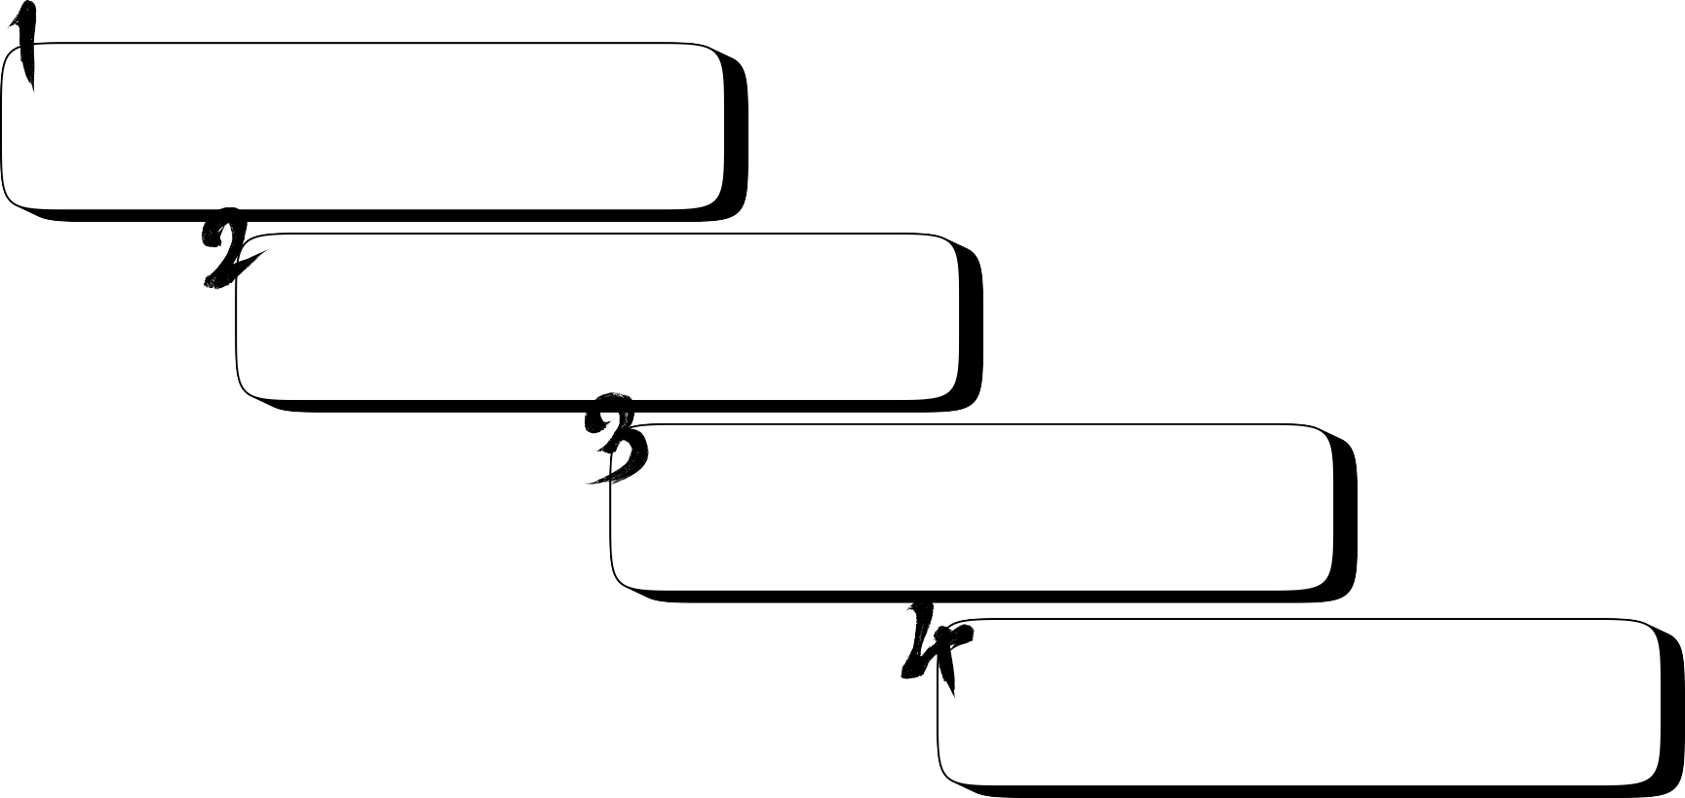
APPLICATIONS
Environmental Monitoring: Helps track air quality trends and pollution levels in different cities.
Health Risk Assessment: Assists in identifying areas with high pollutant exposure, enabling public health actions.
Policy Making: Supports data-driven decisions for air quality improvement initiatives.
Public Awareness: Provides clear visual insights to inform citizens about air quality and potential health impacts.
Page 5 of 31

Slide 6
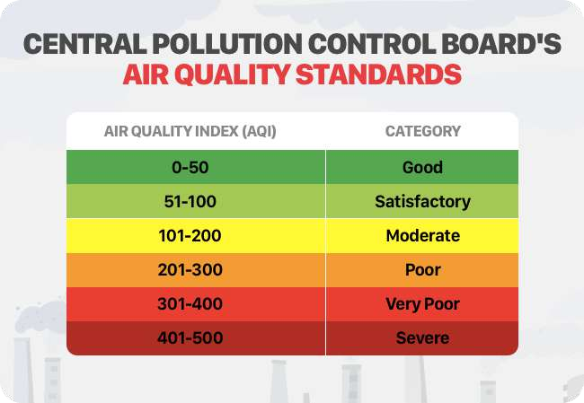
DATA DESCRIPTION
City: Name of the city.
Date: Date of data recording.
Pollutants:
PM 2.5 and PM10
Particulate matter concentration.
NO, NO2, NOx: Nitrogen oxides levels.
NH3: Ammonia concentration.
CO: Carbon monoxide concentration.
SO2: Sulfur dioxide concentration.
O3: Ozone concentration.
Benzene, Toluene, Xylene: Volatile organic compounds.
AQI: Air Quality Index value indicating overall air quality. AQI_Bucket: Categorized AQI level (e.g., Good, Poor, Severe).
Page 6 of 31

Slide 7

Page 7 of 31

Slide 8


Slide 9


Slide 10
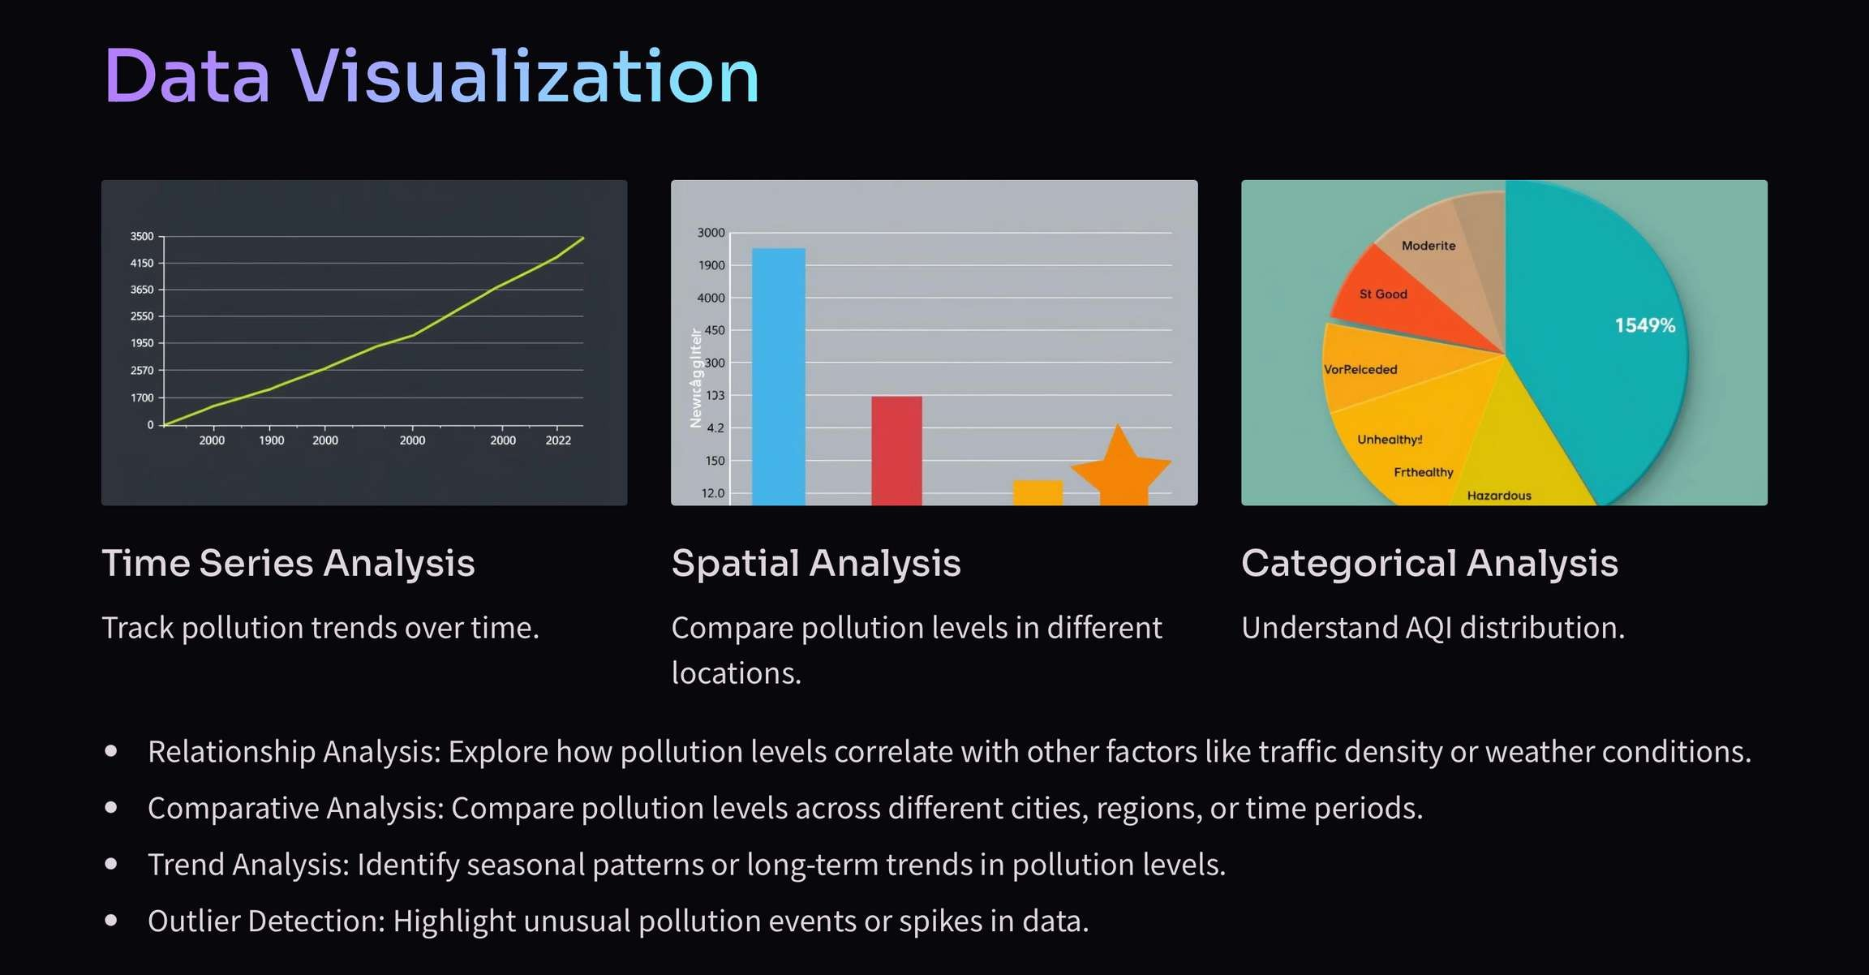

Slide 11
POWER BI
DASHBOARDS

Slide 12
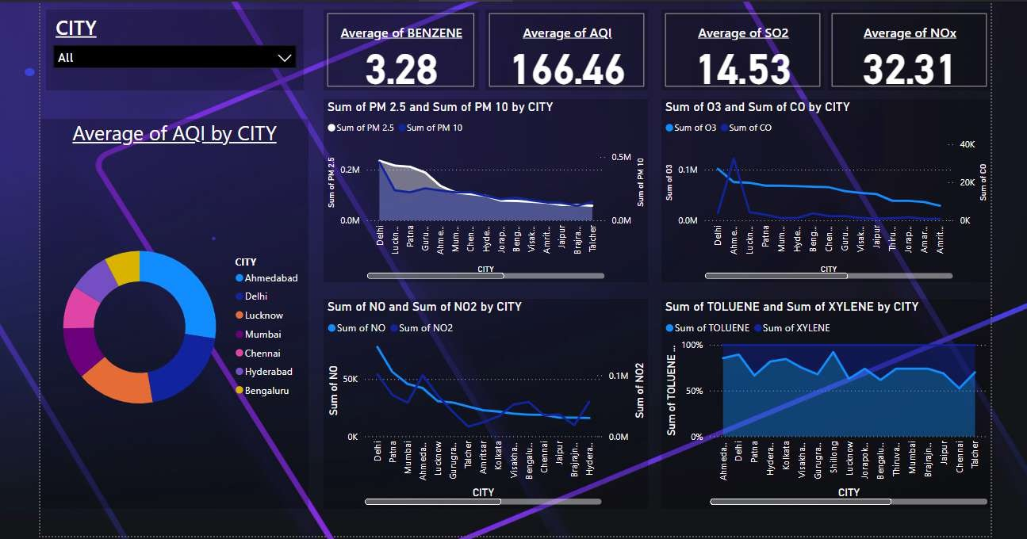

Slide 13
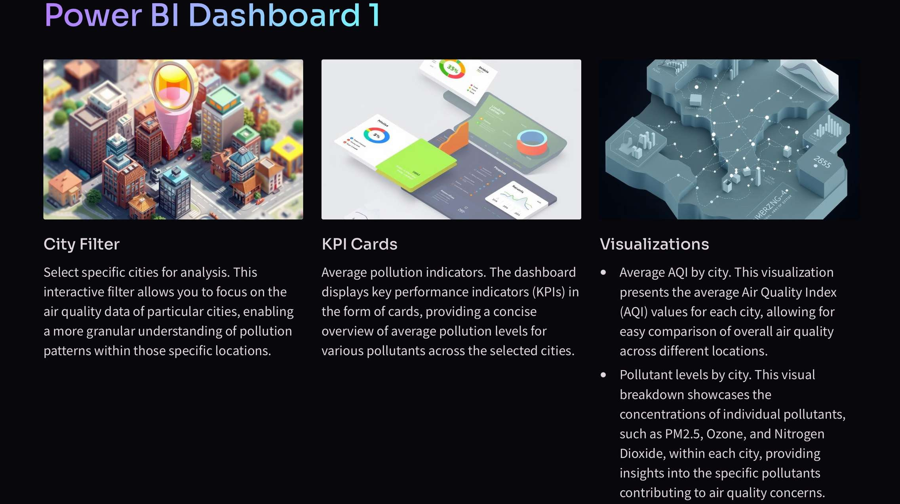

Slide 14
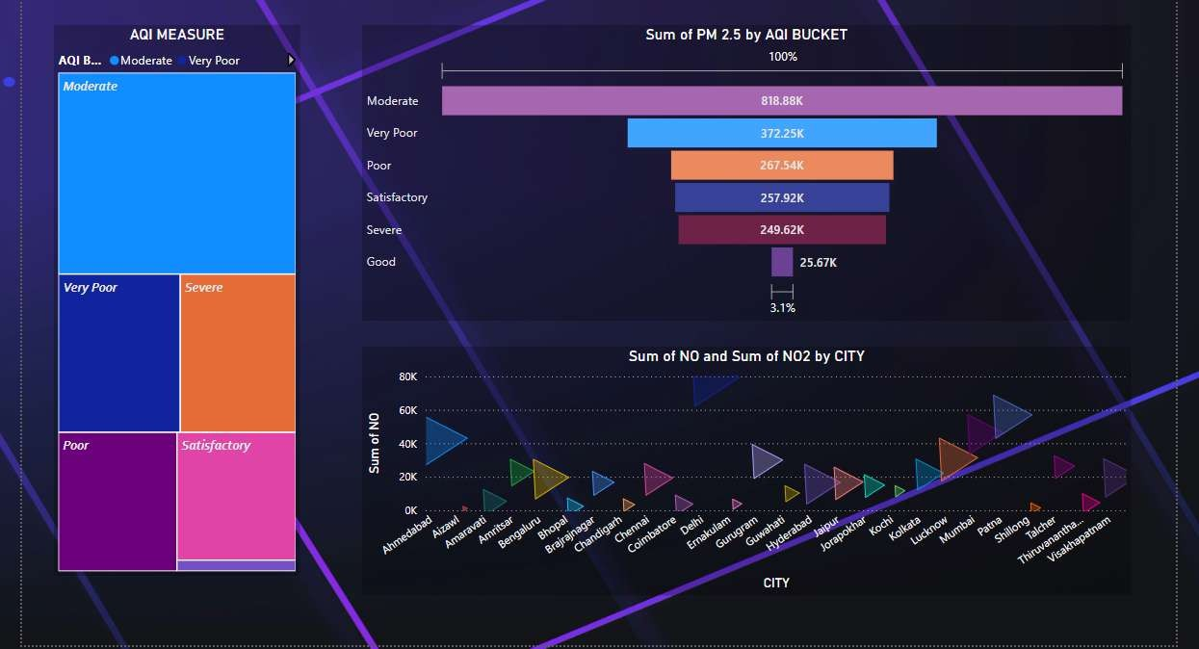

Slide 15
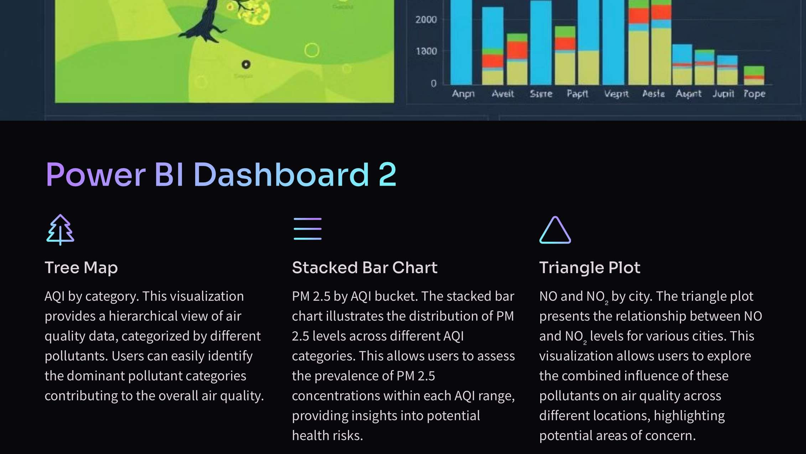

Slide 16
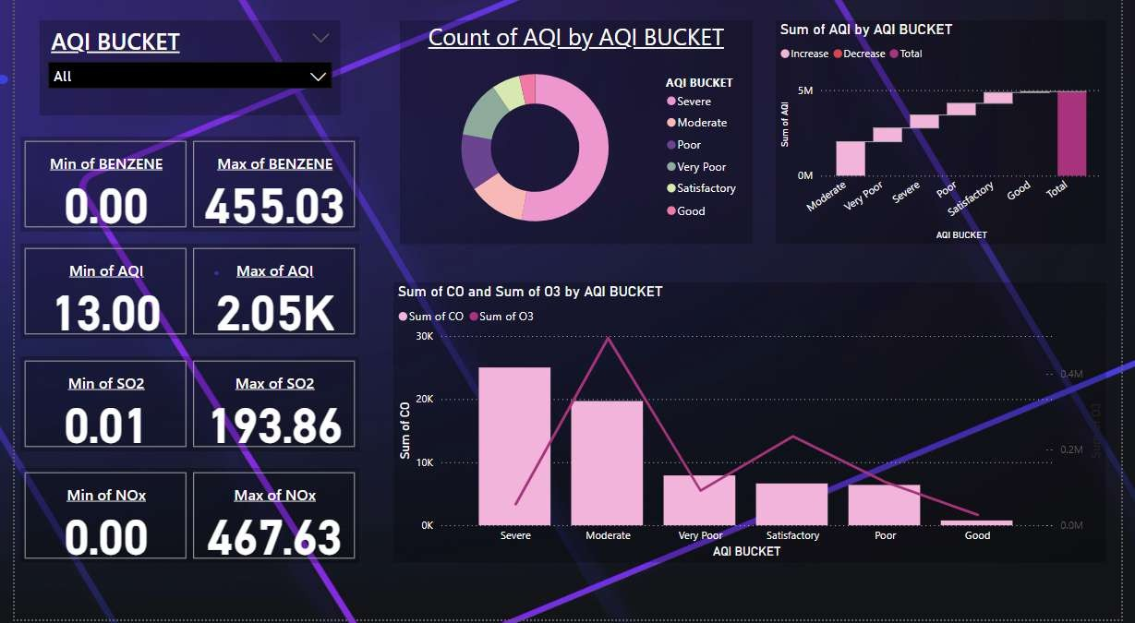

Slide 17
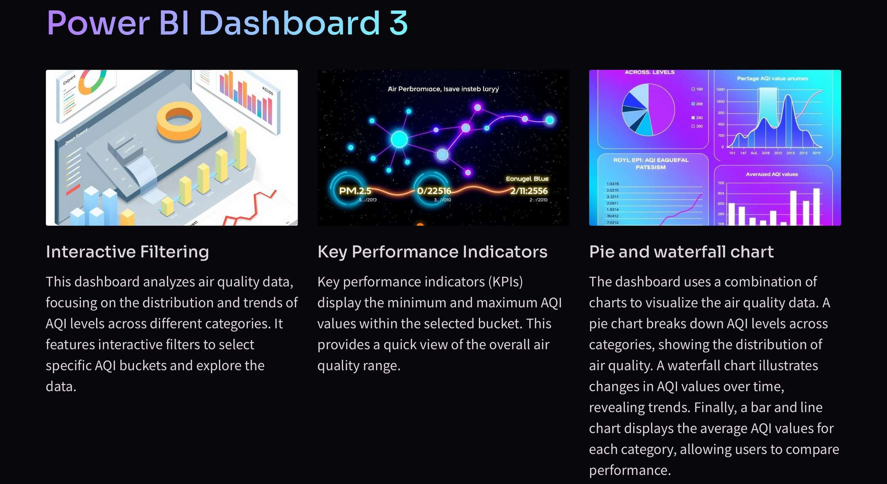

Slide 18
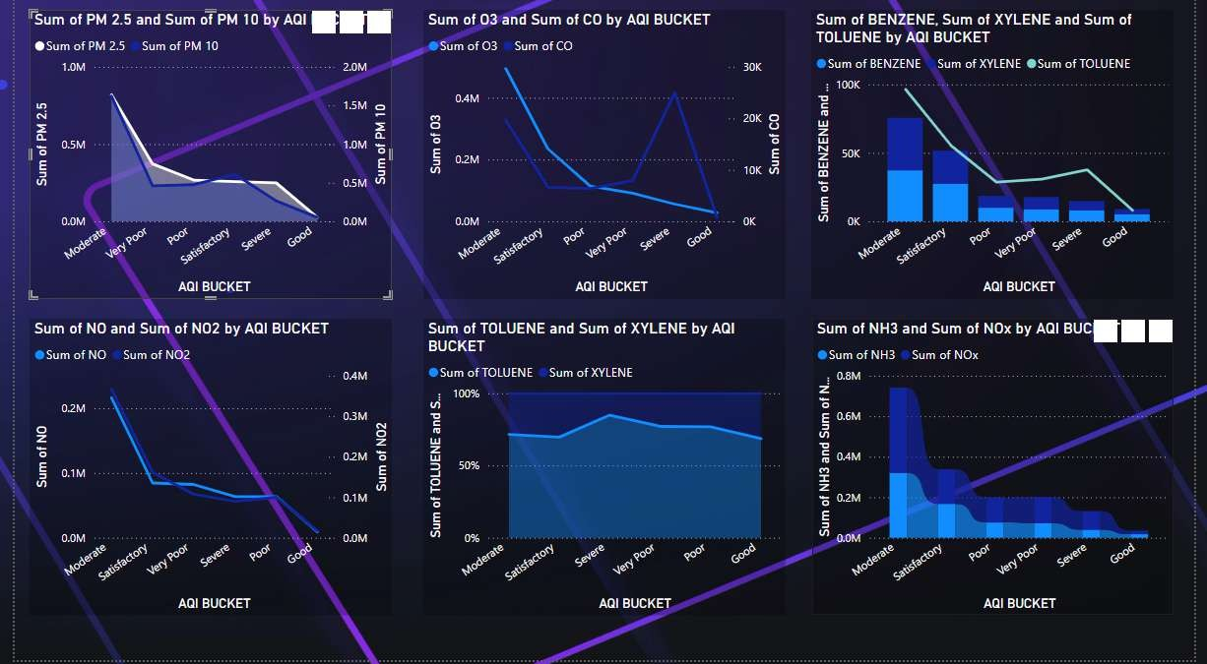

Slide 19
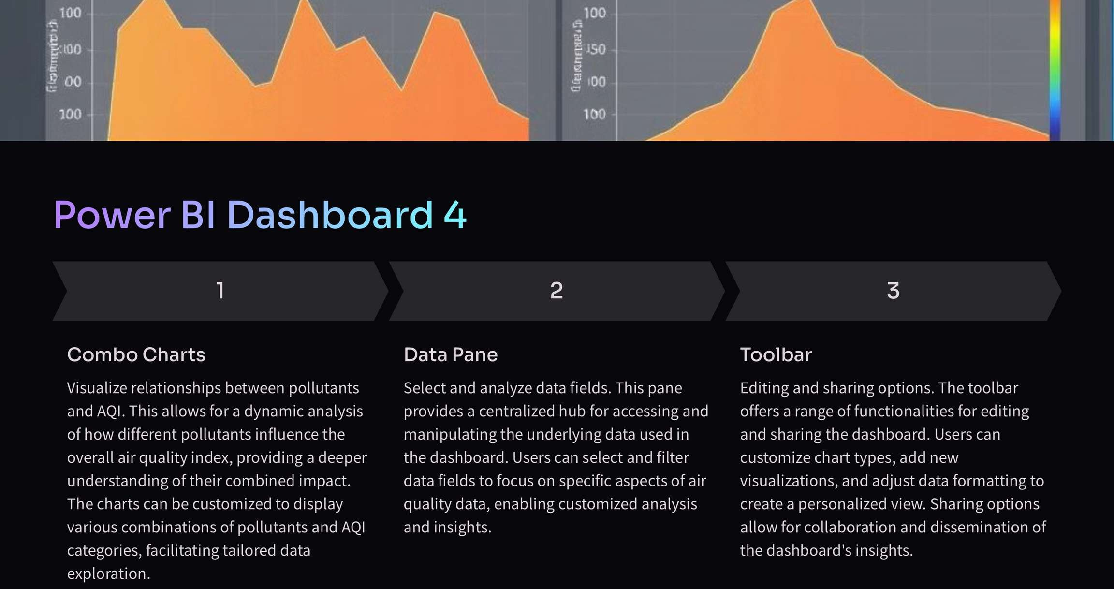

Slide 20







Slide 21

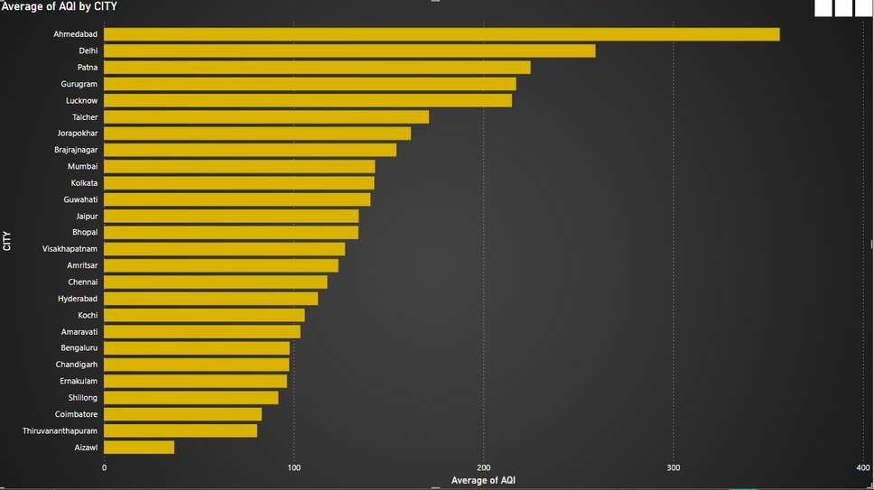
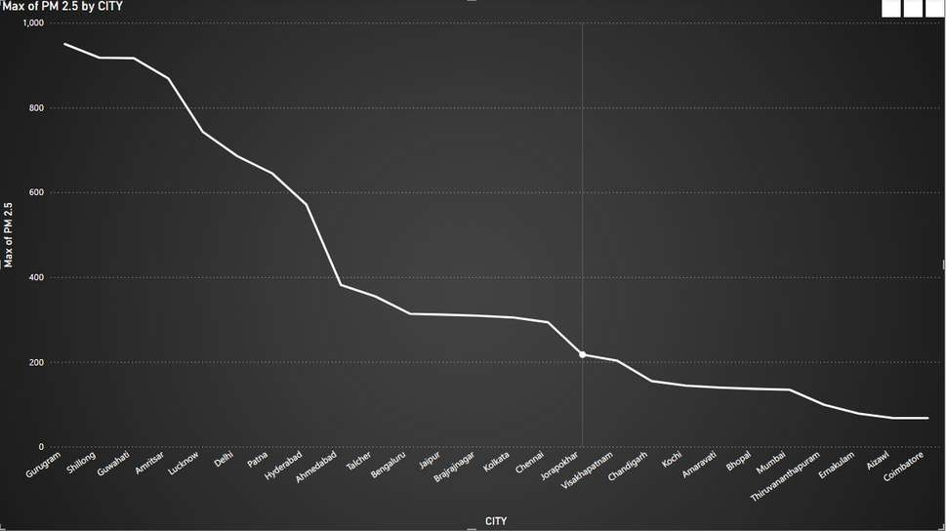
1. What is the average AQI across different cities?
2. Which city has the highest PM2.5 concentration?
At 356.14, Ahmedabad had the highest Average of AQI and was 860.04% higher than Aizawl, which had the lowest Average of AQI at 37.10.
Max of PM 2.5 was highest for Gurugram at 949.99, followed by Shillong and Guwahati.
Across all 26 CITY, Max of PM 2.5 ranged from 67.45 to 949.99.
Across all 26 Cities, Average of AQI ranged from 37.10 to 356.14.

Slide 22
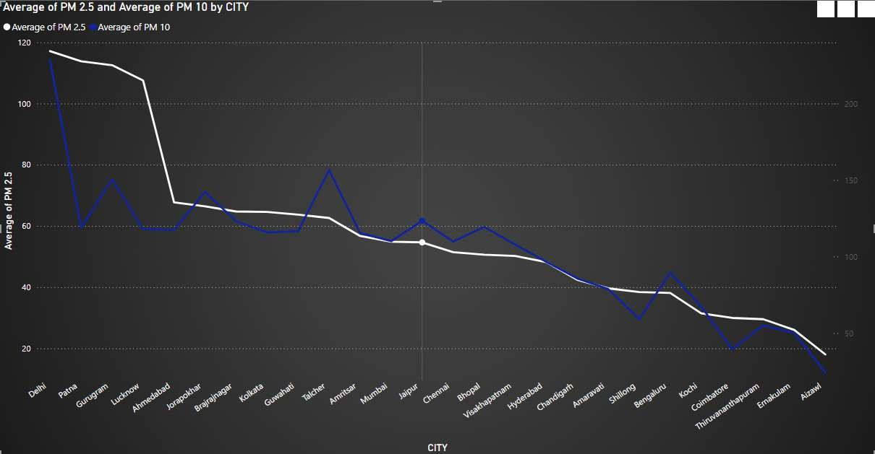
3. How does PM2.5 compare with PM10 across different cities?
At 117.15, Delhi had the highest Average of PM
2.5 and was 550.07% higher than Aizawl, which had the lowest Average of PM 2.5 at
18.02.Average of PM 2.5 and total Average of PM 10 are positively correlated with each other.
Average of PM 10 and Average of PM 2.5 diverged the most when the CITY was Delhi, when Average of PM 10 were 111.27 higher than Average of PM 2.5.
Across all 26 city, Average of PM 2.5 ranged from 18.02 to 117.15 and Average of PM 10 ranged from 24.19 to 228.41.Max of PM 2.5 was highest for Gurugram at 949.99, followed by Shillong and Guwahati.

Slide 23
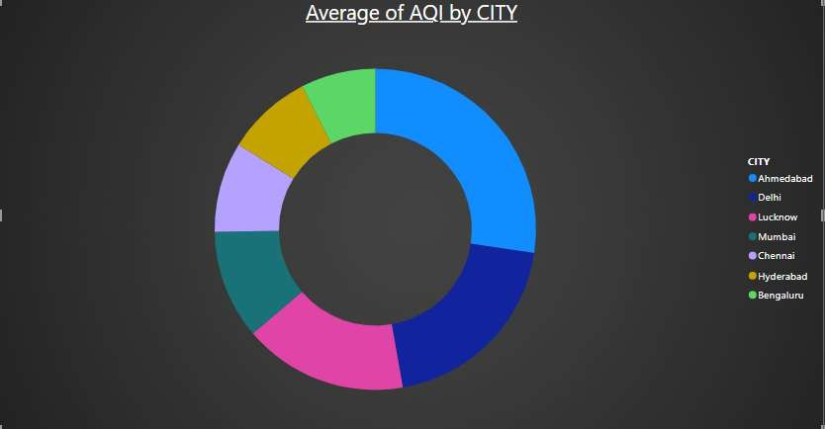
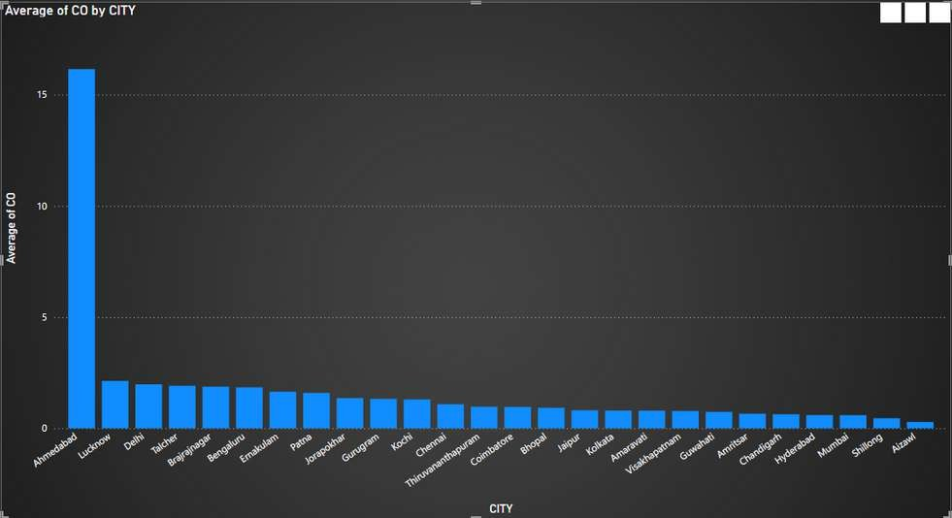
4. What is the distribution of AQI across cities (based on AQI_Bucket)?
5. Which city has the lowest levels of Carbon Monoxide (CO)?
Average of PM 10 and Average of PM 2.5 diverged the most when the CITY was Delhi, when Average of PM 10 were 111.27 higher than Average of PM 2.5.
Average of PM 2.5 and total Average of PM 10 are positively correlated with each other.
At 16.15, Ahmedabad had the highest Average of CO and was 5,593.31% higher than Aizawl, which had the lowest Average of CO at 0.28.
Across all 26 CITY, Average of CO ranged from 0.28 to 16.15.

Slide 24
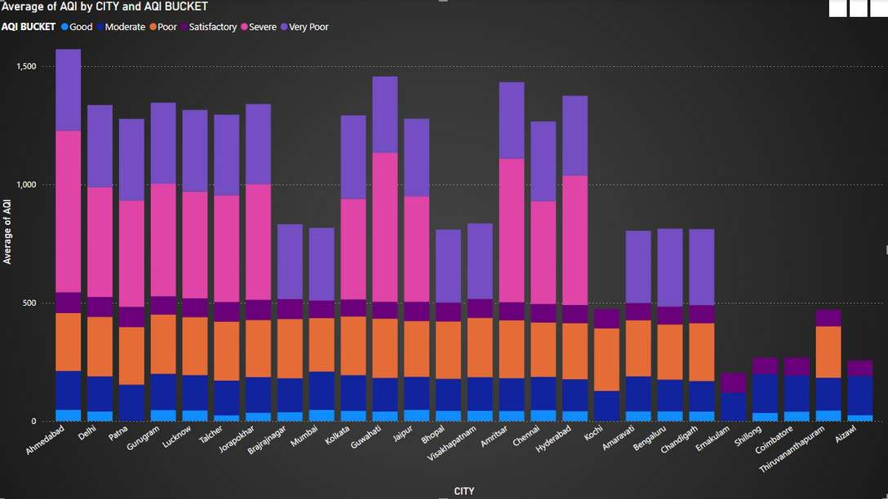
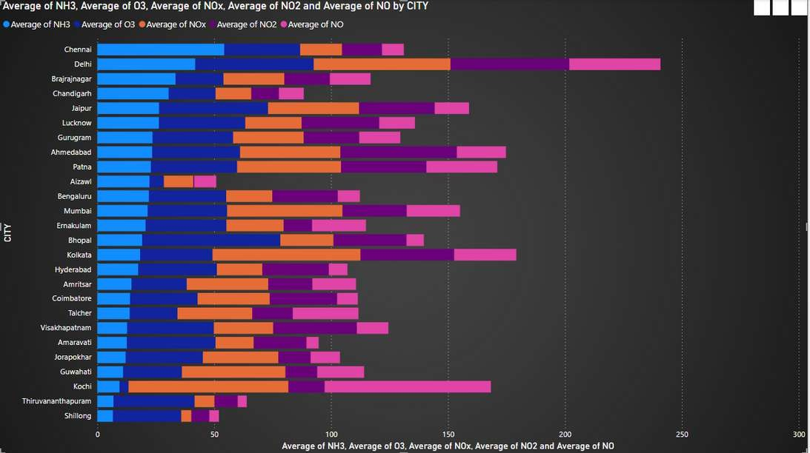
6. What is the distribution of AQI across different AQI buckets (Good, Moderate, Unhealthy, etc.) for
each city?
7. Which pollutant (PM2.5, PM10, NO, NO2, etc.) has the highest concentration across all cities?

Slide 25
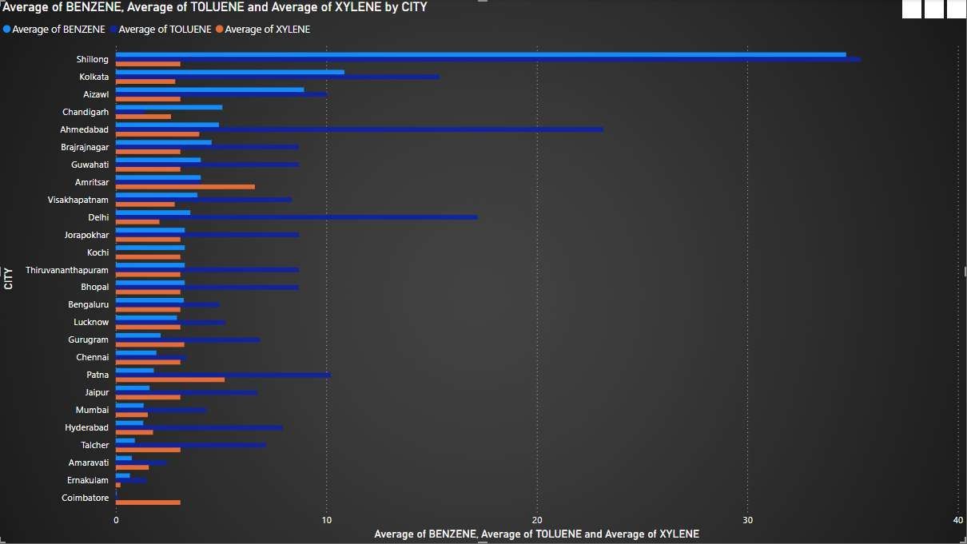
8. Which city has the highest levels of Benzene, Toluene, and Xylene?
Max of PM 2.5 was highest for Gurugram at 949.99, followed by Shillong and Guwahati.
Across all 26 CITY, Max of PM 2.5 ranged from 67.45 to 949.99.
Average of PM 2.5 and total Average of PM 10 are positively correlated with each other.
Average of PM 10 and Average of PM 2.5 diverged the most when the city was Delhi, when Average of PM 10 were
111.27 higher than Average of PM 2.5.

Slide 26
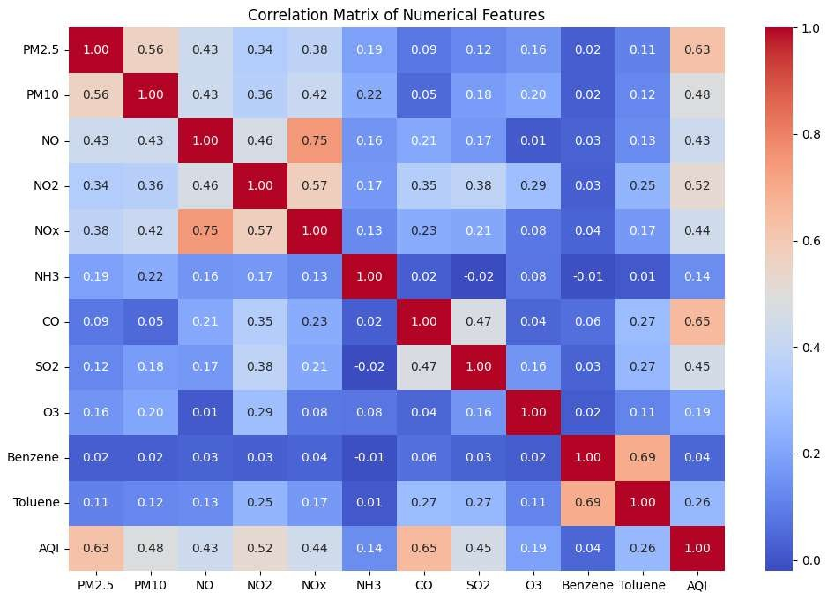
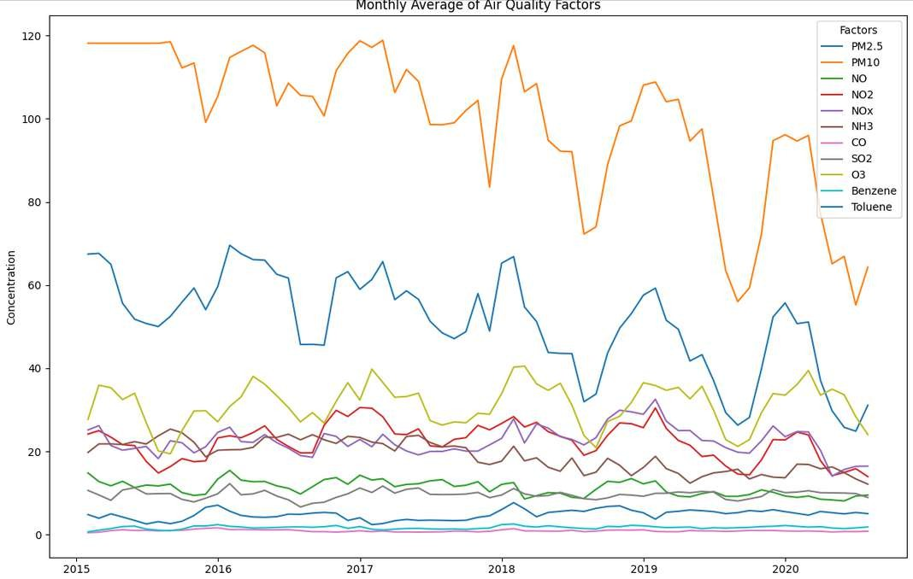
9. What is the relationship between Ozone (O3) concentration and other pollutants like PM2.5 and
NO2?
10.What is monthly average of Air Quality Factors?

Slide 27
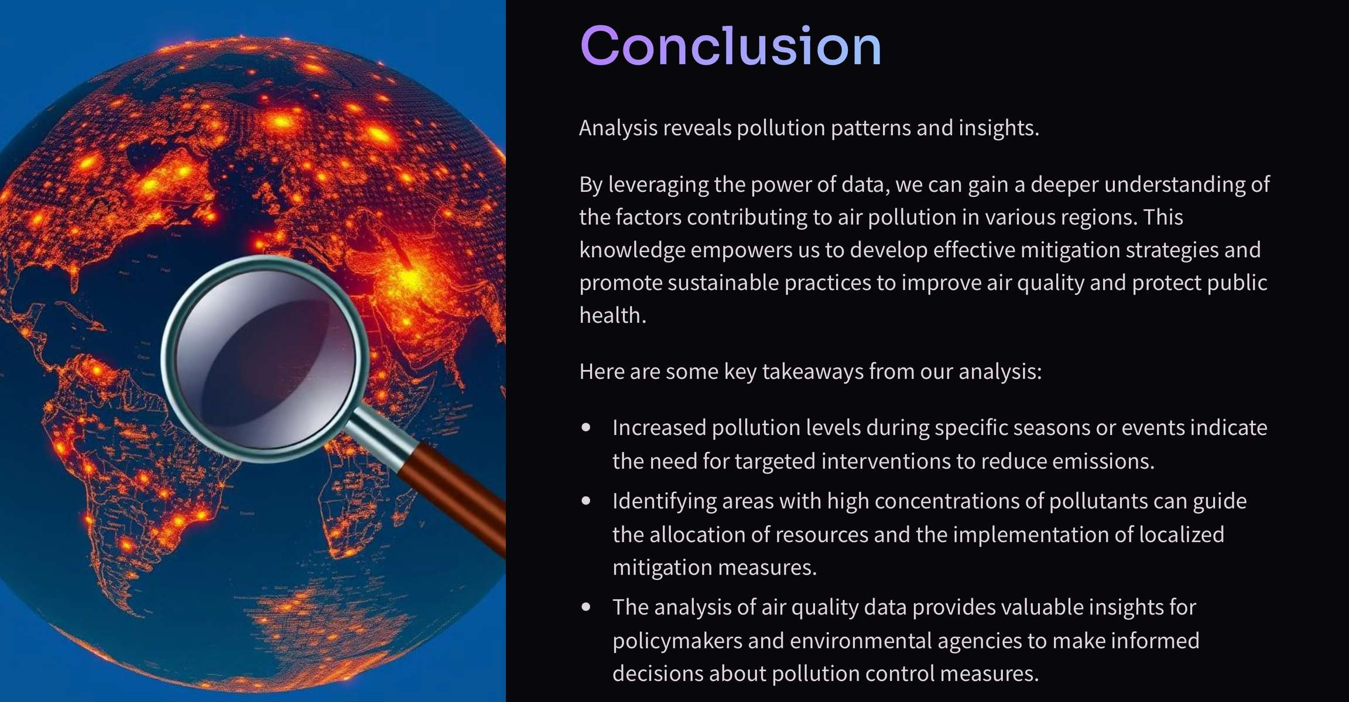

Slide 28
REFERENCES
Air Quality Data: Dataset from Kaggle on pollutant levels and AQI readings across cities.
https://www.kaggle.com/datasets/rohanrao/air-quality -data-in-india
Weather Data: Real-time and historical weather data from the Indian Government National Weather. https://www.data.gov.in/resource/real-time-air-quality -index-various-locations
Pollutant Health Guidelines: WHO guidelines on safe air pollutant levels and health impacts.
https://www.who.int/health-topics/air-pollution#tab=tab_1
AQI Standards: EPA resources on AQI categories and health effects of pollution & Google Collab for Python. https://colab.research.google.com/
Page 30 of

Slide 29

PROJECT BY :-
BT23CSD006 BT23CSD013 BT23CSD015 BT23CSD019
THANK YOU
Page 31 of 31

